Slide 1
Menu

Slide 2




Slide 3
Project

Slide 4







Proef 1

Slide 5


Proef 2

Slide 6


Proef 3

Slide 7


Proef 4

Slide 8


Proef 5

Slide 9


Proef 6

Slide 10
Richting

Slide 11


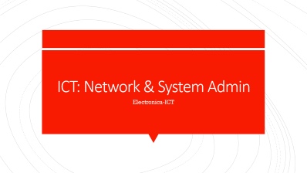

Slide 12
Electronica: Hardware Engineer
Electronica-ICT

Slide 13
Fiche

Slide 14
ICT: Network & System Admin
Electronica-ICT

Slide 15
Fiche

Slide 16
ICT: Software engineer & AI
Electronica-ICT

Slide 17
Fiche

Slide 18
Game

Slide 19
Snake

